Slide 1
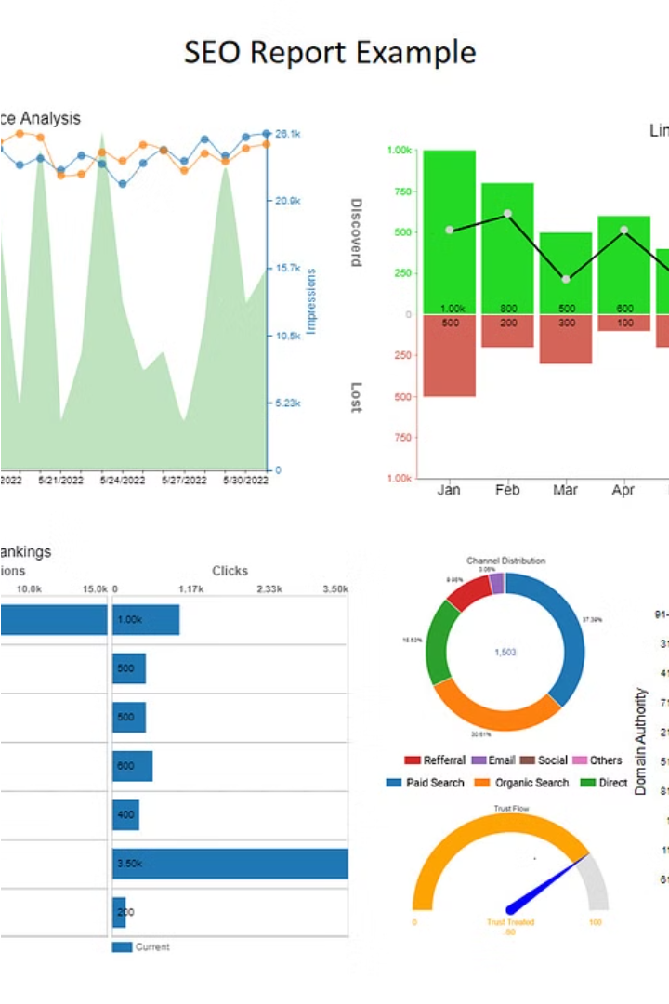
Loan Dataset Analysis Report
This report presents an analysis of a loan dataset aimed at identifying factors influencing loan default, with the goal of reducing credit losses for a leading online loan marketplace.
by Angeline A

Slide 2
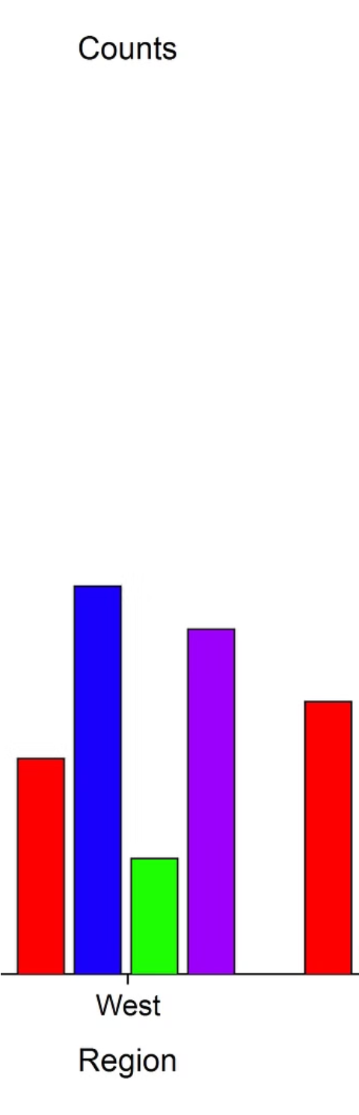
Data Loading and Initial Exploration
The dataset was loaded and explored to understand its structure and initial characteristics. This involved examining the data types, identifying missing values, and understanding the distribution of key variables.
1
Data Structure
2
Missing Values
The dataset contained information about various loan attributes, including loan amount, interest rate, loan term, borrower's credit history, and loan status.
The presence of missing values was assessed, and strategies for handling them were determined. Columns with more than 50% missing values were dropped, while missing data in remaining columns were imputed using appropriate methods.
3
Data Type Corrections
String percentages in the 'int\_rate' column were converted to float format for analysis, ensuring consistency and accuracy in calculations.

Slide 3
Exploratory Data Analysis (EDA)
EDA involved visualizations to explore relationships and distributions within the dataset. This provided insights into key variables and their potential influence on loan default.
1
Loan Amount Distribution
Histograms revealed a peak in loan amounts around $5,000-$10,000 post-cleaning, indicating a normal distribution.
2
Interest Rates and Loan Status
Boxplots showed that higher interest rates correlate with higher default rates, while lower rates are associated with higher fully paid rates.
3
Loan Status Breakdown
Loan status breakdown indicated a larger proportion of loans are fully paid compared to charged off, aligning with interest rate impact observations.
4
Loan Grade Breakdown
Loan grade breakdown showed that Grade B loans are most prevalent.
5
Term vs Loan Status
Term vs Loan Status plot revealed that 36-month terms are more popular, with balanced default rates compared to longer terms.
6
Subgrade vs Loan Status
Subgrade vs Loan Status plot highlighted: Borrowers in A and B subgrades predominantly pay loans properly. C subgrades show an equal split between paying and not paying. D subgrades vary in loan performance. E and F subgrades tend to have higher instances of not paying. G subgrades show mixed performance across subcategories.
7
Employment Length vs Loan Status
Employment Length vs Loan Status plot indicated: Longer employment length correlates with wider installment ranges, with some outliers. Variability in installment payments exists across different employment lengths, notably around 7 years.
8
Homeownership vs Loan Status
Homeownership vs Loan Status showed: Most borrowers are renters or have a mortgage. Fewer borrowers own their homes. Overall, homeownership status does not significantly impact loan payment behavior.
9
Purpose vs Installment
Purpose vs Installment plot revealed: Loans for house, small business, credit card, and debt consolidation have higher installment amounts. Car and vacation loans have lower installment amounts. Other purposes (home improvement, medical, education, wedding, renewable energy) show moderate installment amounts.
10
Address State vs Loan Status
Address State vs Loan Status highlighted: Top states for loan issuance include California, New York, Texas, Florida, and New Jersey. States with lower loan issuance include Montana, North Dakota, and Wyoming.

Slide 4
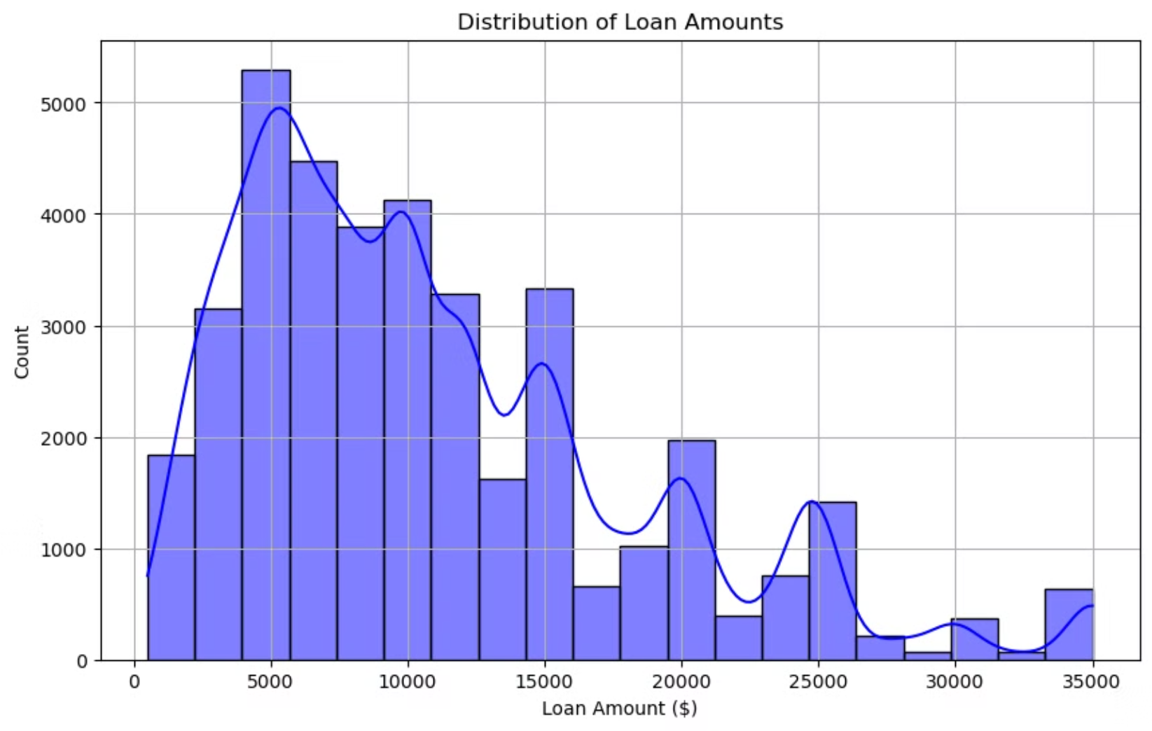

Slide 5
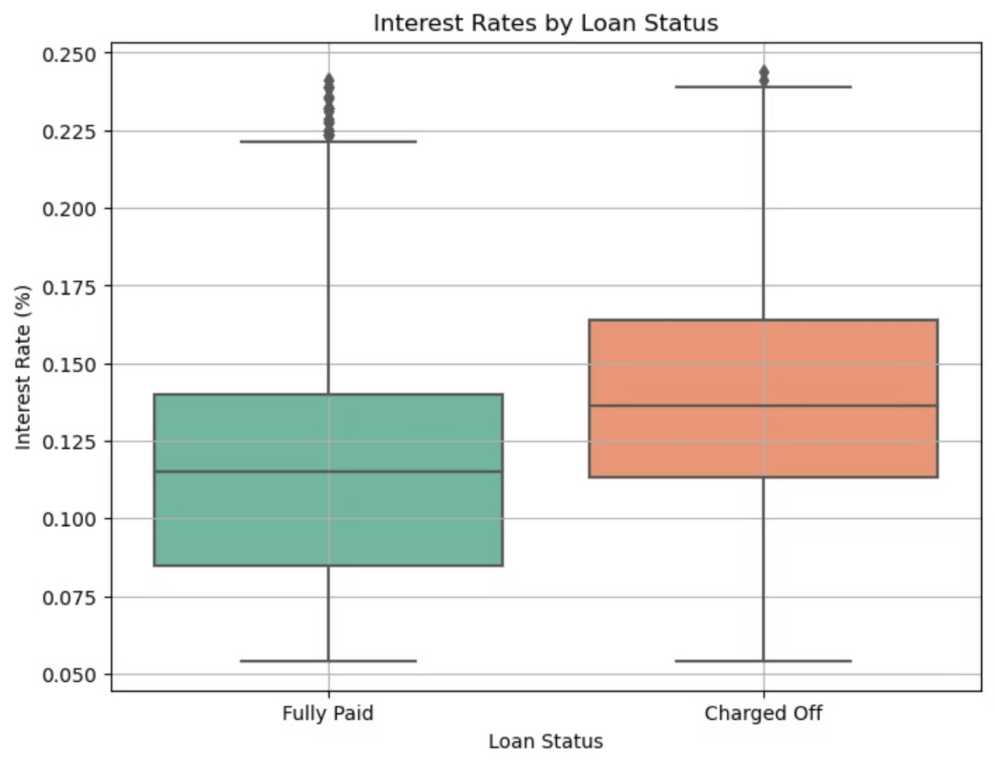

Slide 6
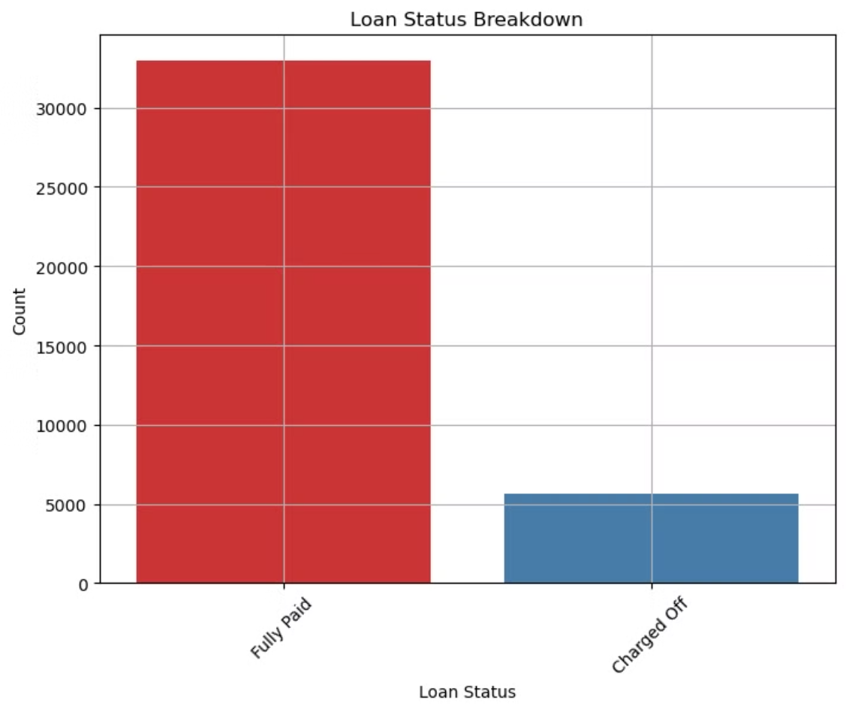

Slide 7
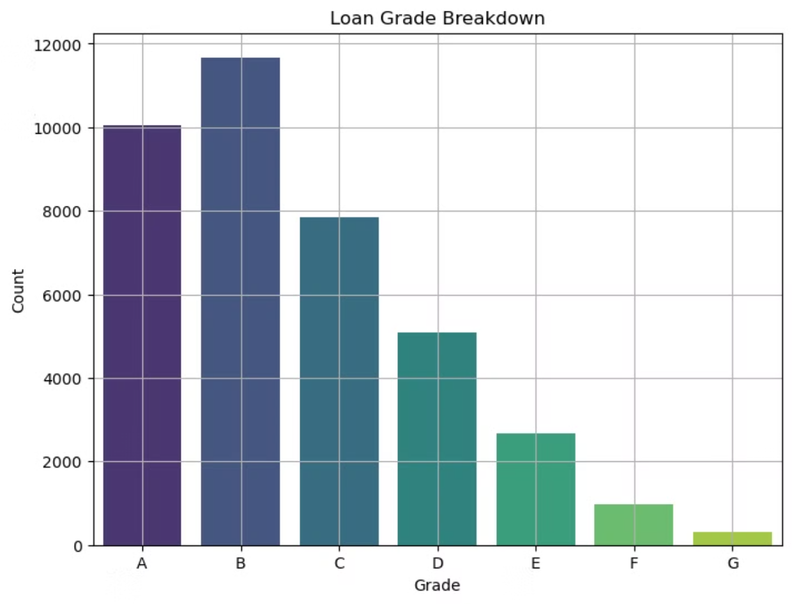

Slide 8
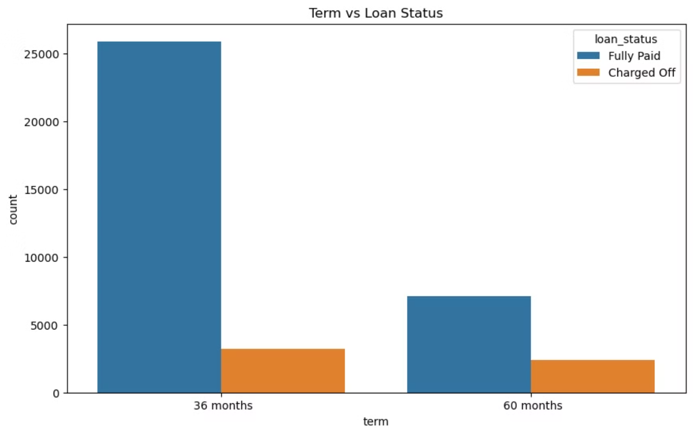

Slide 9
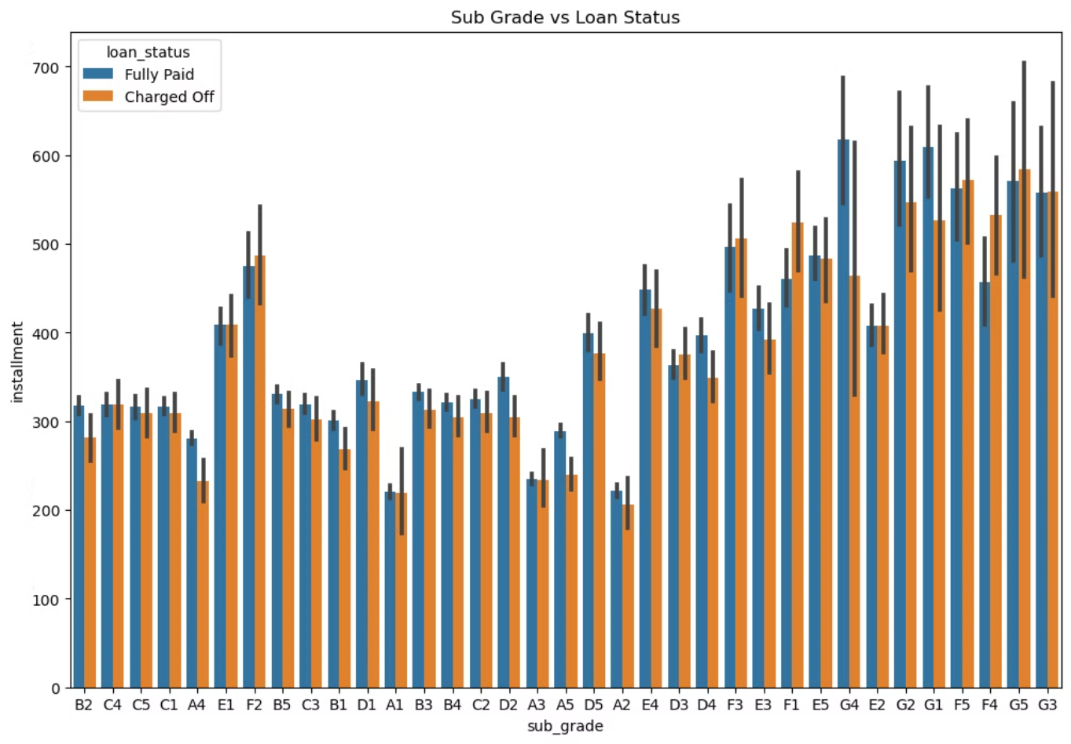

Slide 10
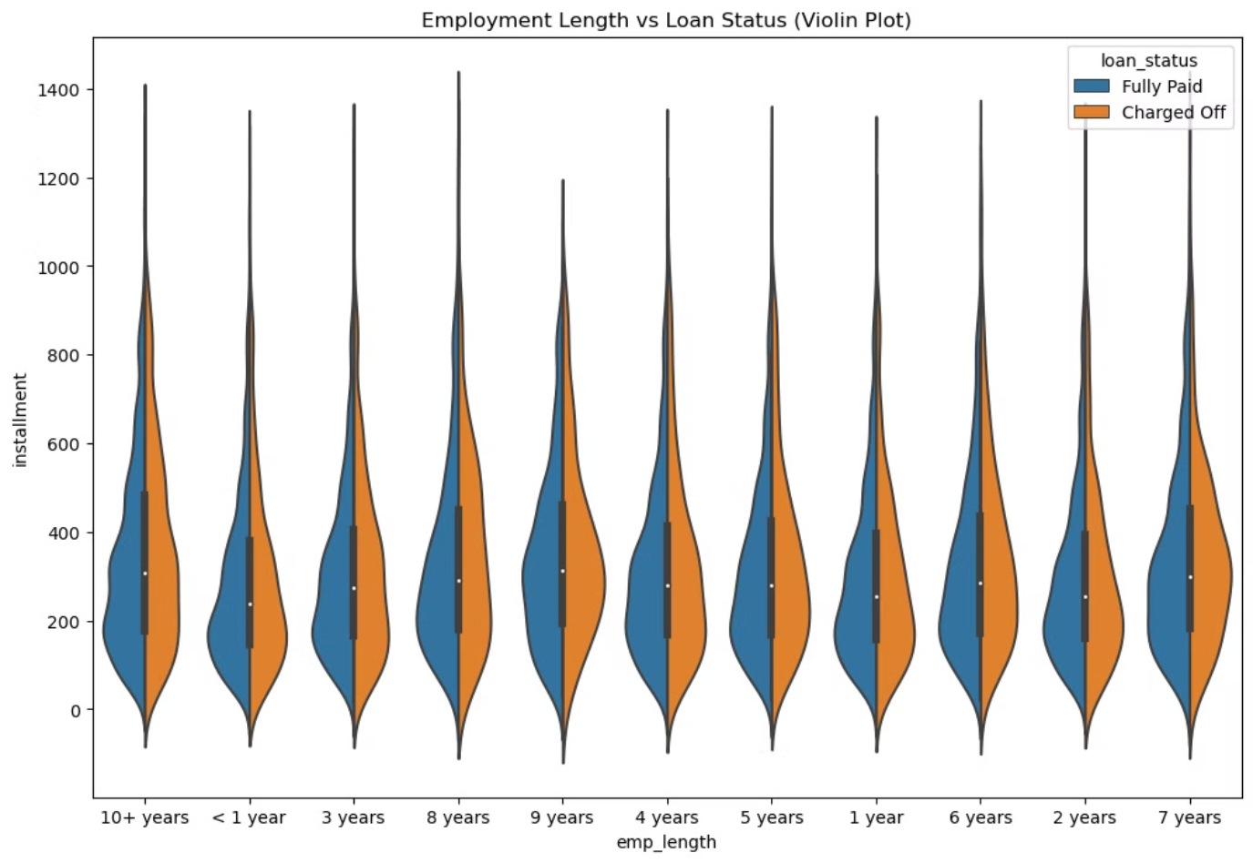

Slide 11
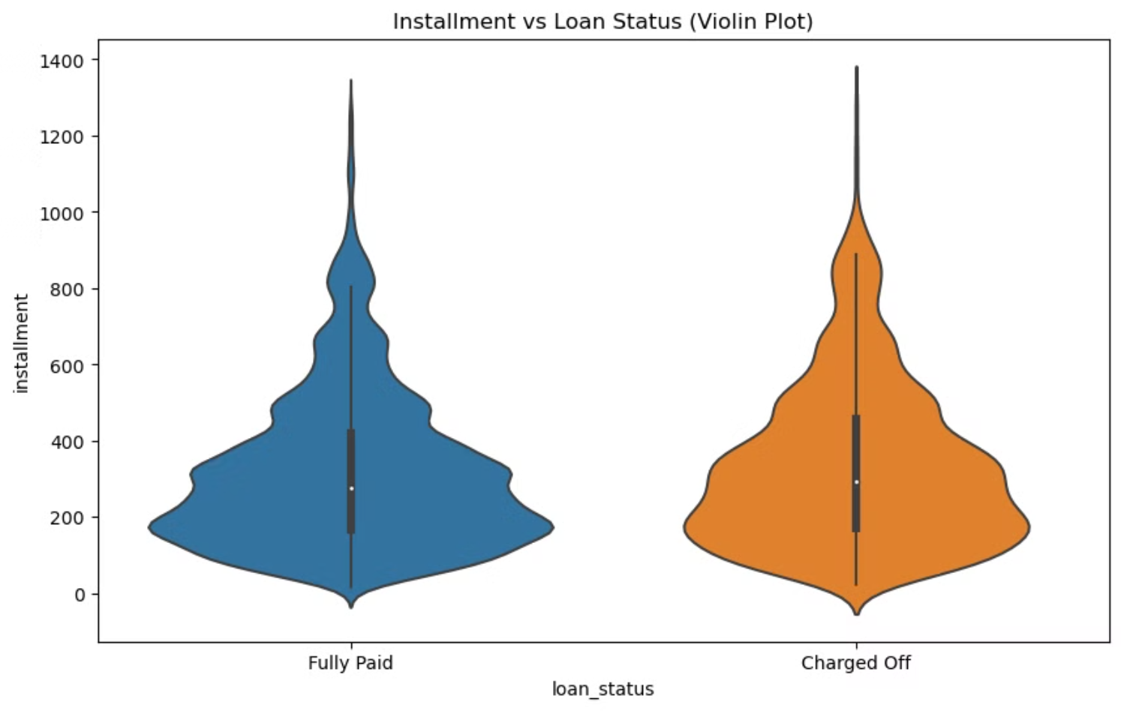

Slide 12
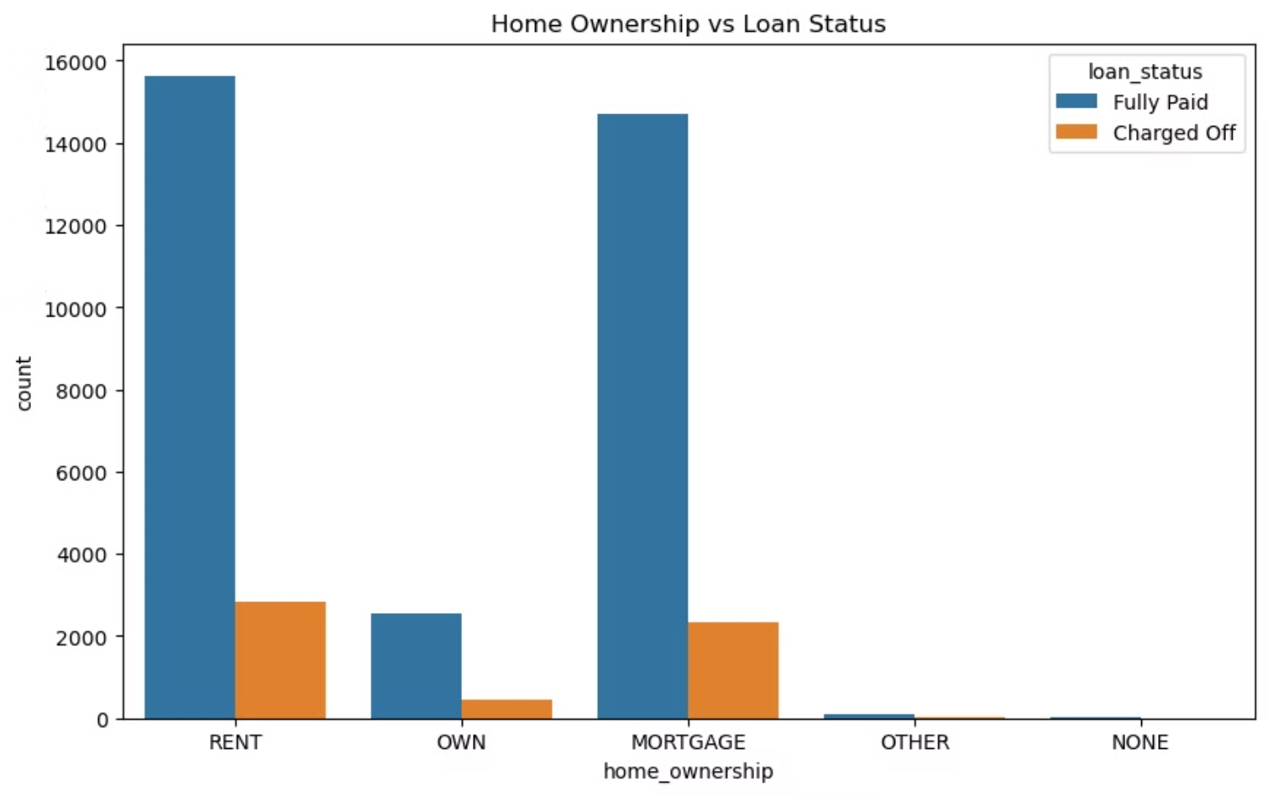

Slide 13
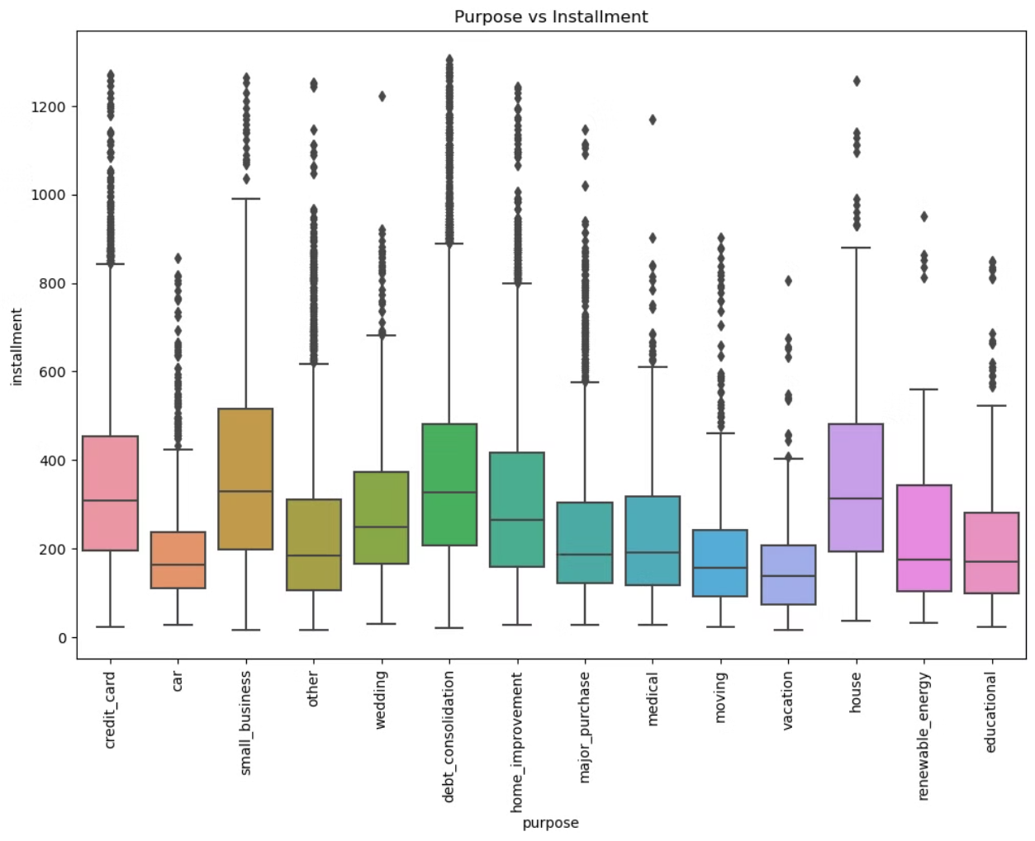

Slide 14
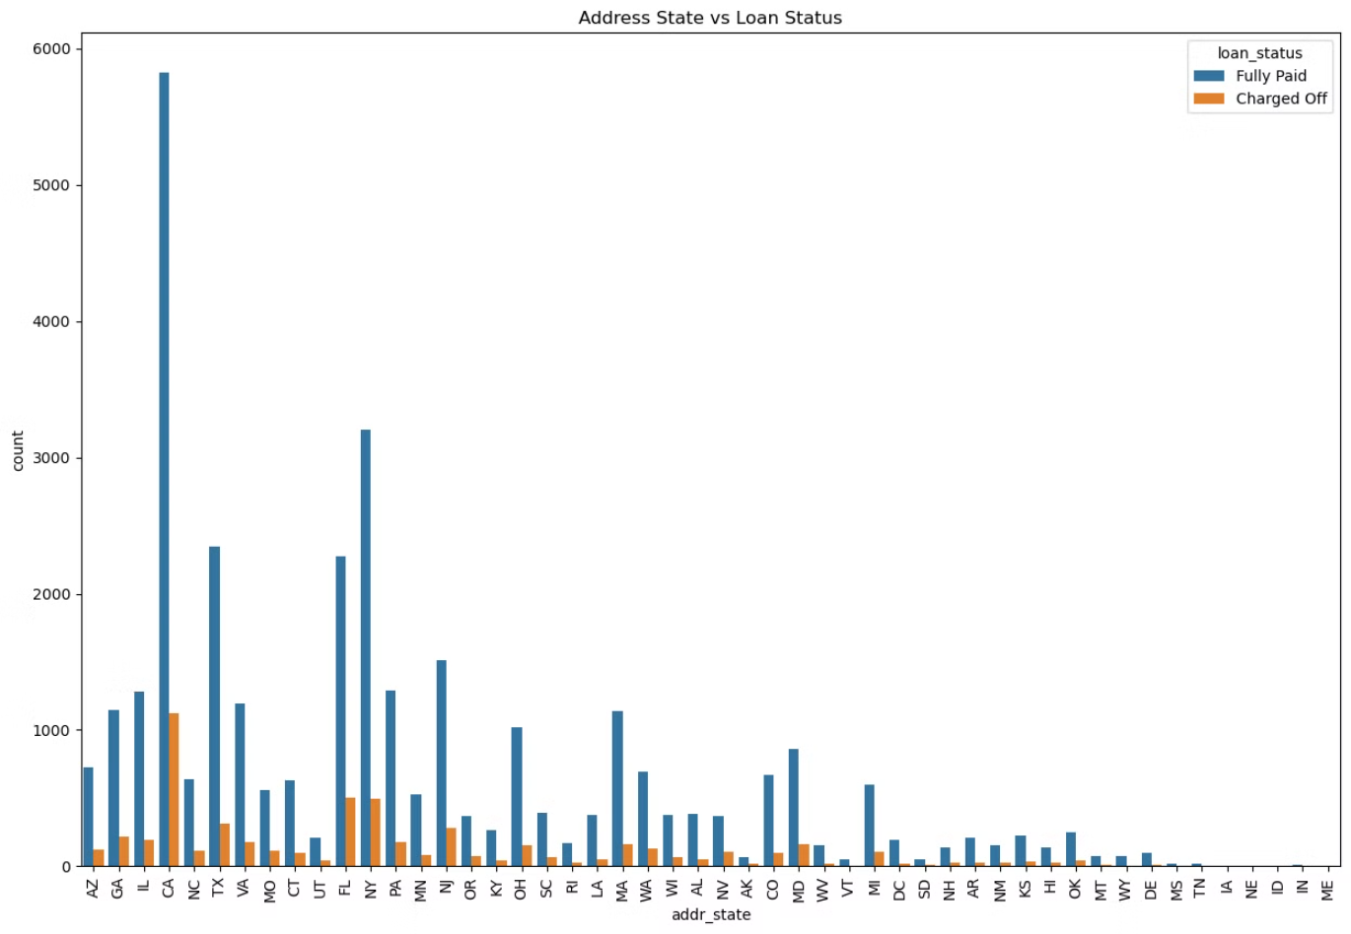

Slide 15
Correlation Analysis
Correlation analysis with 'loan\_status' highlighted significant variables that influence loan default. This analysis helps identify key factors that contribute to loan repayment behavior.
Factors Positively Correlated with Default
Factors Negatively Correlated with Default
Higher interest rates ('int\_rate')
Recovery efforts ('recoveries', 'collection\_recovery\_fee')
Sub-grade ('sub\_grade')
Payment amounts ('last\_pymnt\_amnt', 'total\_pymnt\_inv', 'total\_pymnt')
Term length ('term')

Slide 16
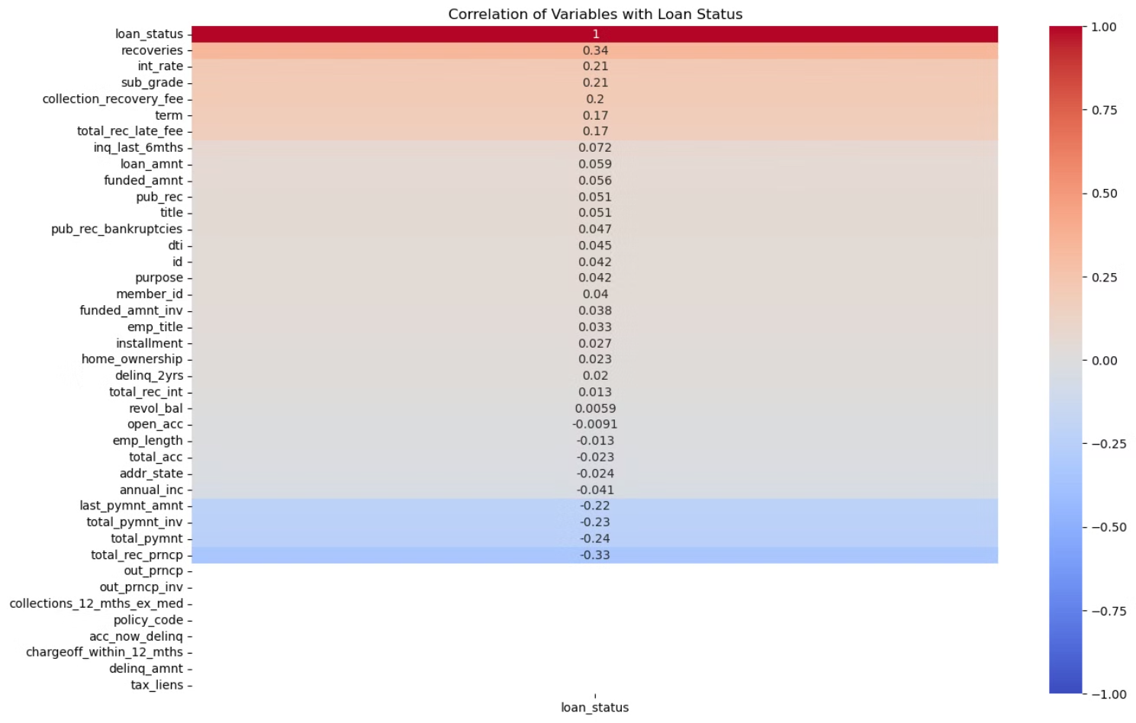

Slide 17
Insights
The analysis provides valuable insights into the factors influencing loan default, guiding strategic decisions to mitigate credit losses effectively.
Loan Amount Distribution
Interest Rates and Loan Status
Most loans fall within $5,000-$10,000, indicating a common borrowing pattern.
Higher interest rates are associated with higher default rates, underscoring the importance of interest rate setting in risk assessment.
Subgrade Analysis
Employment Length
Subgrades A and B generally indicate lower risk, whereas lower subgrades (E, F) show higher default rates.
Variability in installment payments suggests that longer employment history does not guarantee lower risk uniformly.
Homeownership and Purpose
Geographic Insights
These variables have varying impacts on installment amounts but do not strongly influence loan repayment behavior uniformly.
States with higher loan volumes may require targeted risk assessment strategies due to varied economic conditions and borrower profiles.

Slide 18
Recommendations
Based on the insights gained from the analysis, the following recommendations are proposed to optimize risk assessment strategies and enhance loan portfolio performance.
1
Risk Assessment
2
Segmentation Strategy
3
Monitoring and Recovery
Implement detailed risk models incorporating subgrade analysis, employment length insights, and geographic considerations.
Tailor loan offerings based on purpose-specific risk profiles identified (e.g., higher risk associated with vacations versus debt consolidation).
Enhance monitoring and recovery strategies for loans with higher default probabilities, focusing on subgrades E and F.
4
Continuous Analysis
5
Enhanced Due Diligence
Regularly update risk models based on emerging patterns in borrower behavior and economic conditions across states.
Strengthen due diligence processes for states with higher loan issuance volumes, ensuring robust risk management.

